Slide 1
New Zealand Election
2026

Slide 2
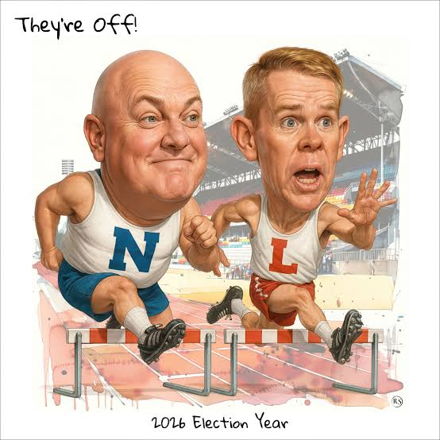
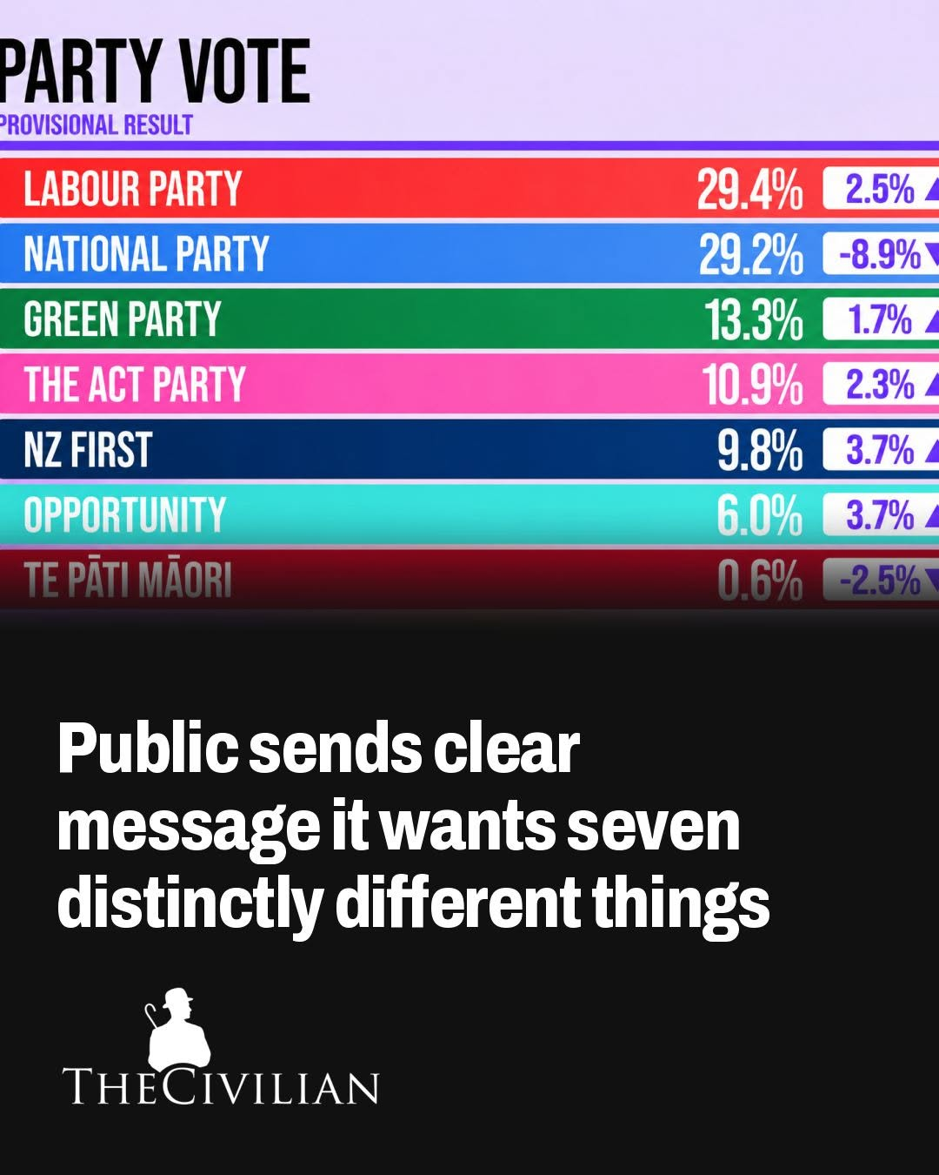
“New Zealand has spoken, but we’re not sure what they’ve said yet.” – Chris Hipkins (Labour Party leader)

Slide 3
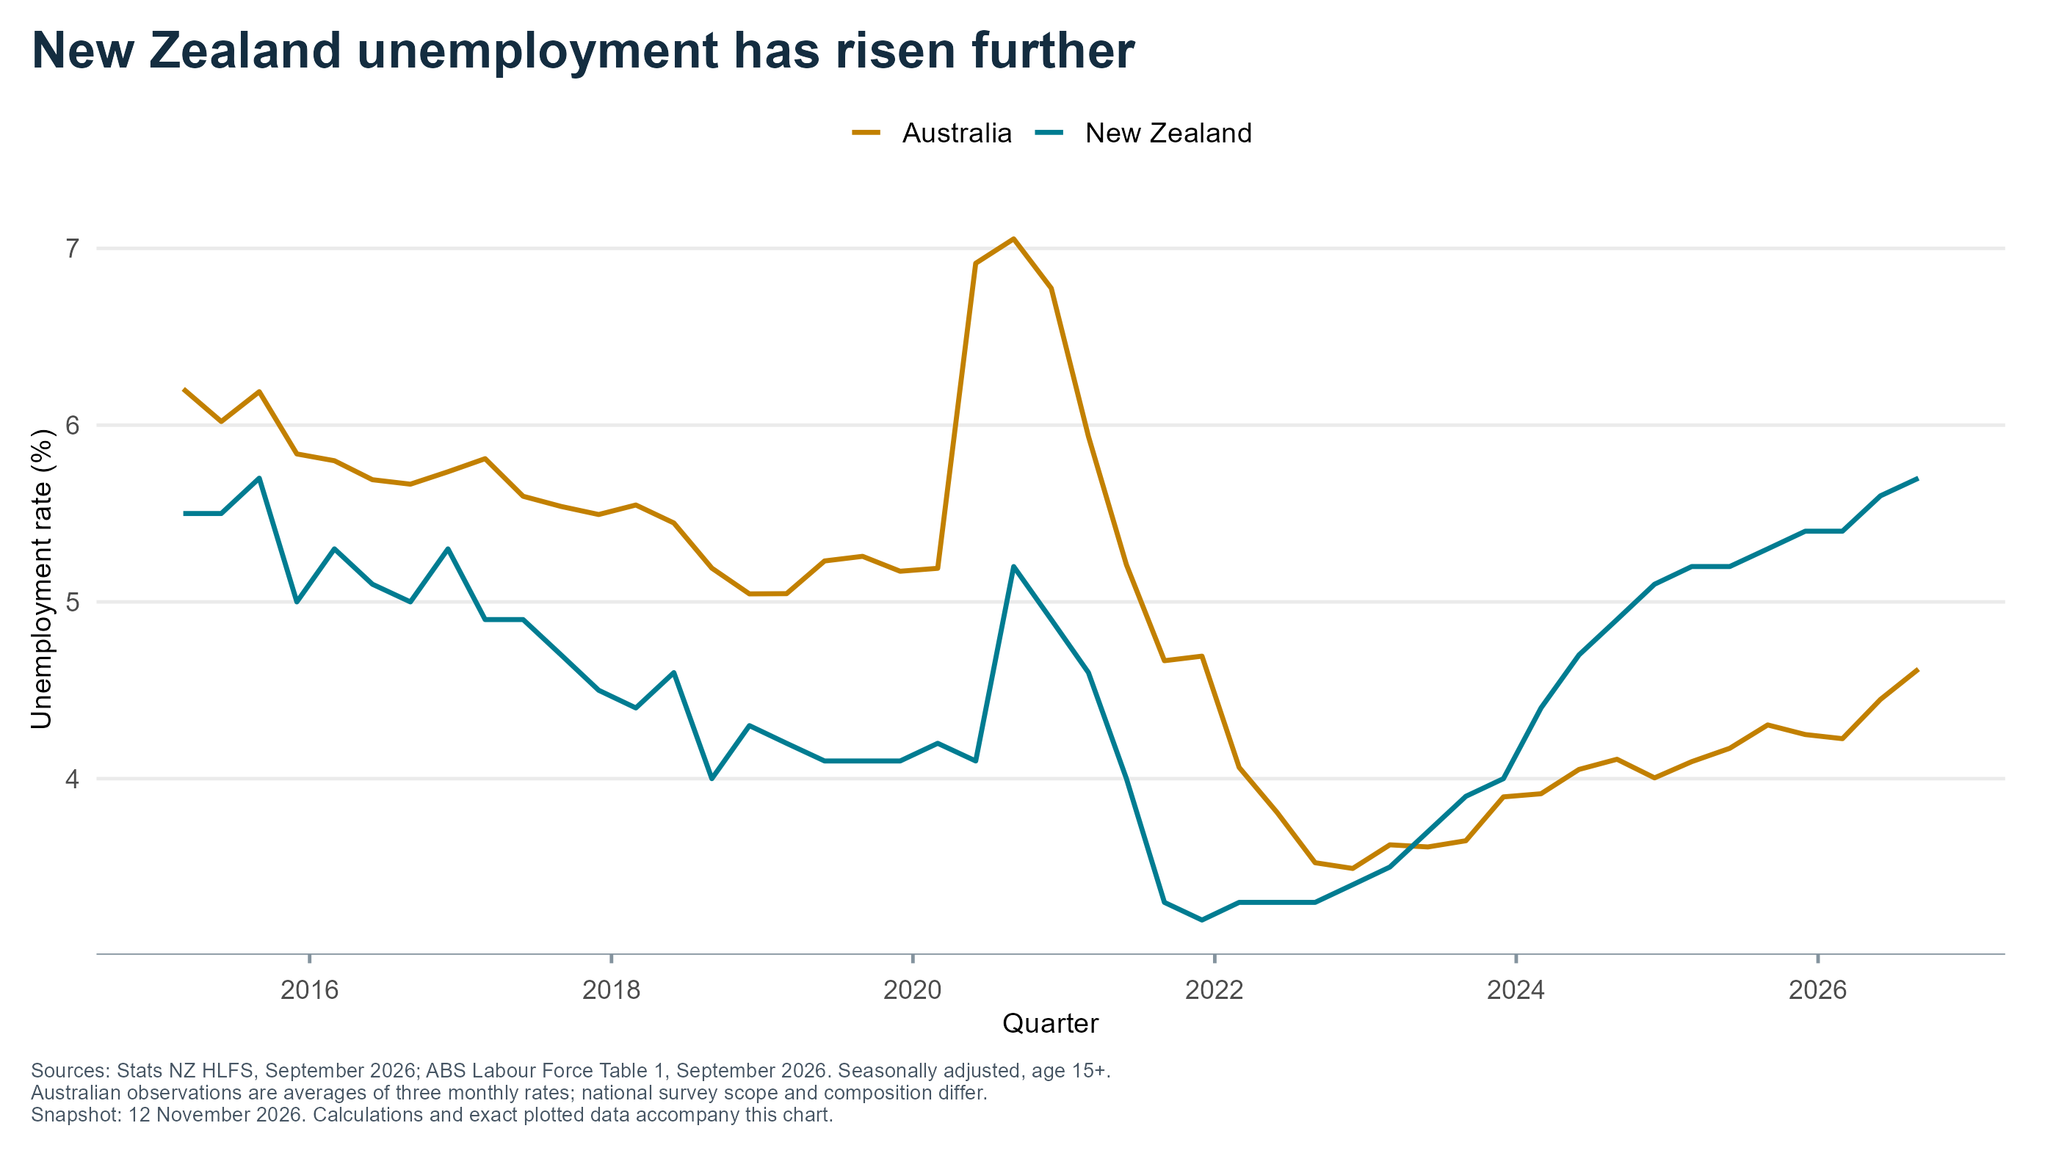
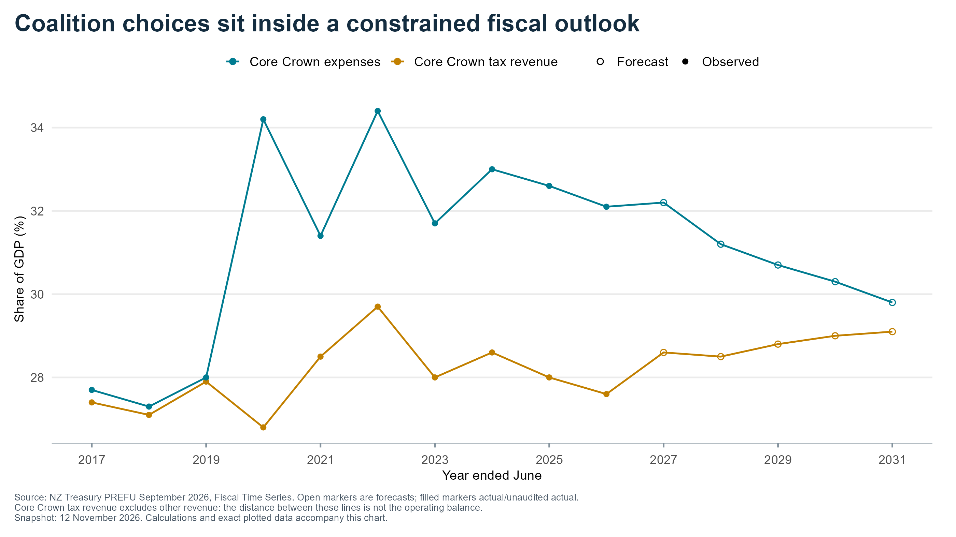
Background of NZ election
Economic stress
Similar weak GDP growth, with more unemployment.
Fiscal situation considerably worse (current and projected).
Electoral reform and breakdown in electoral “norms”
2023 “1 tick” strategy by Māori party.
Centre-right copied in rural electorates this time.
Opportunity “feels like” the 1996 version of NZF.

Slide 4
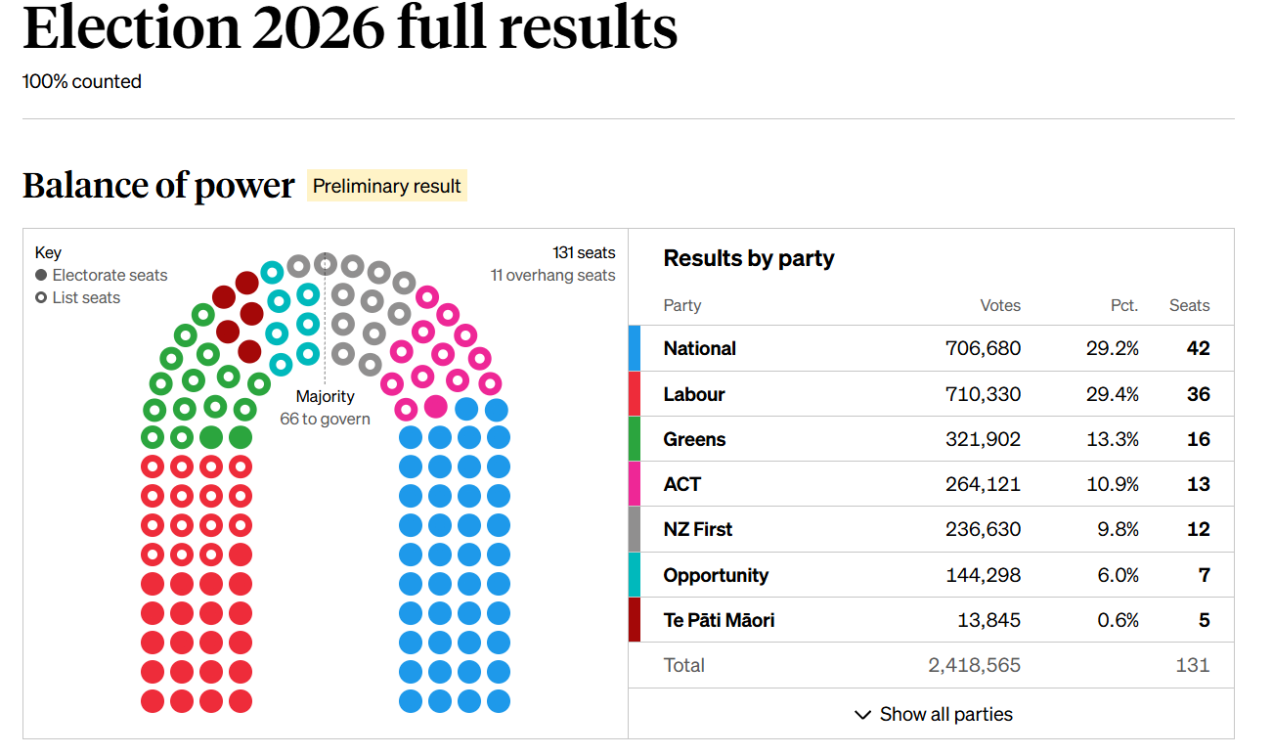
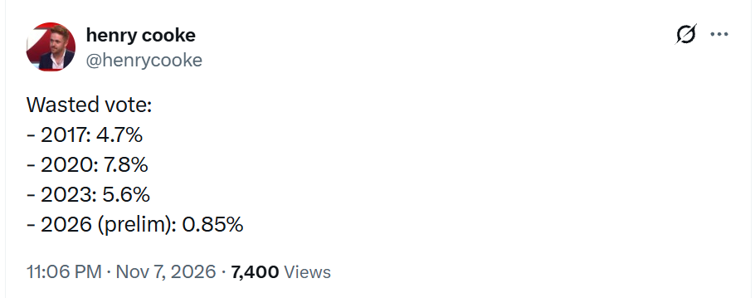
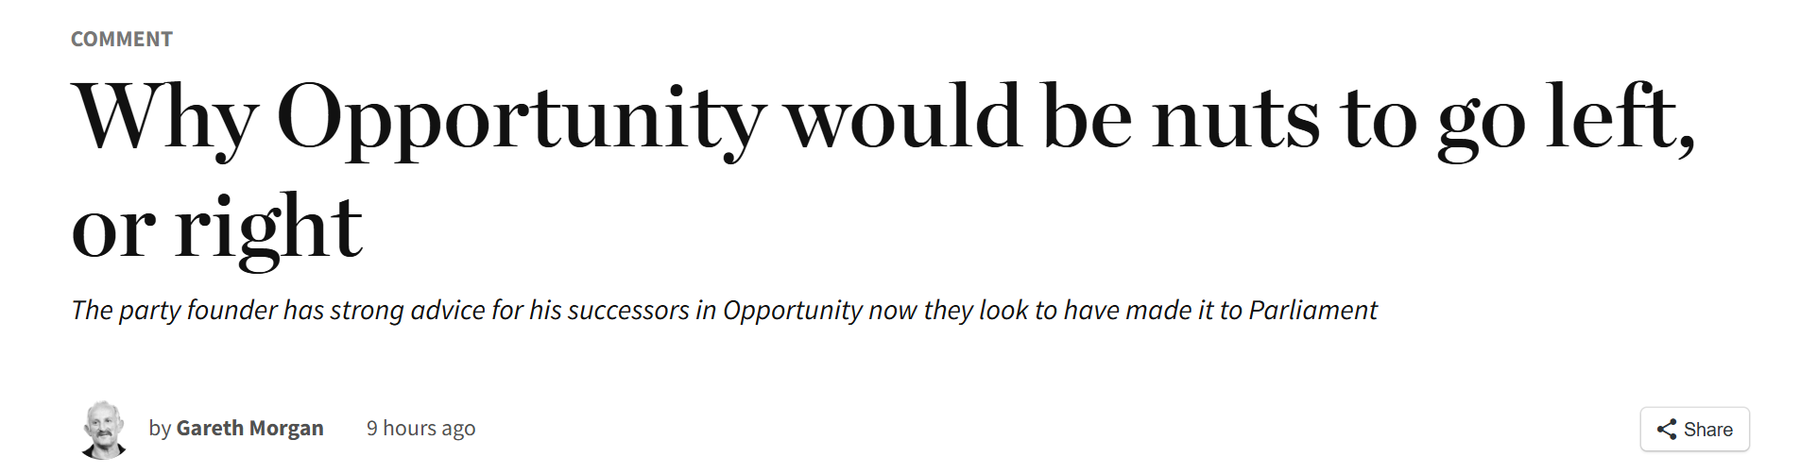
What were the results?
120 seats split proportionally by party vote.
Overhang: But there is 71 electorates. If you win more electorates than party vote you get to keep them.
Parliament now 131 seats!

Slide 5
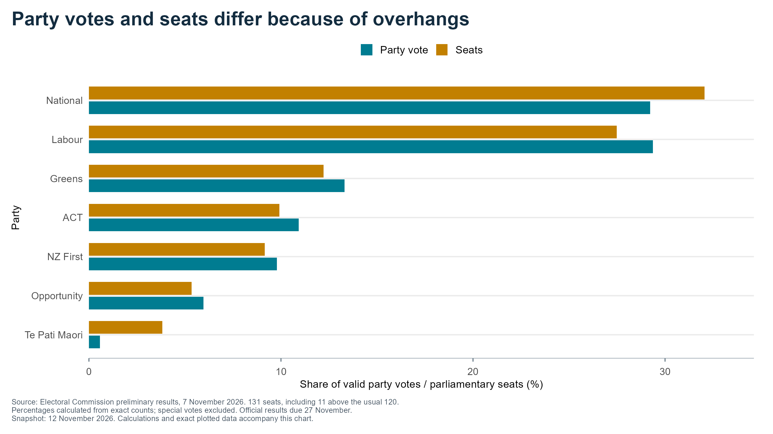
Disproportional parliament – but centre-right did receive majority of the votes

Slide 6
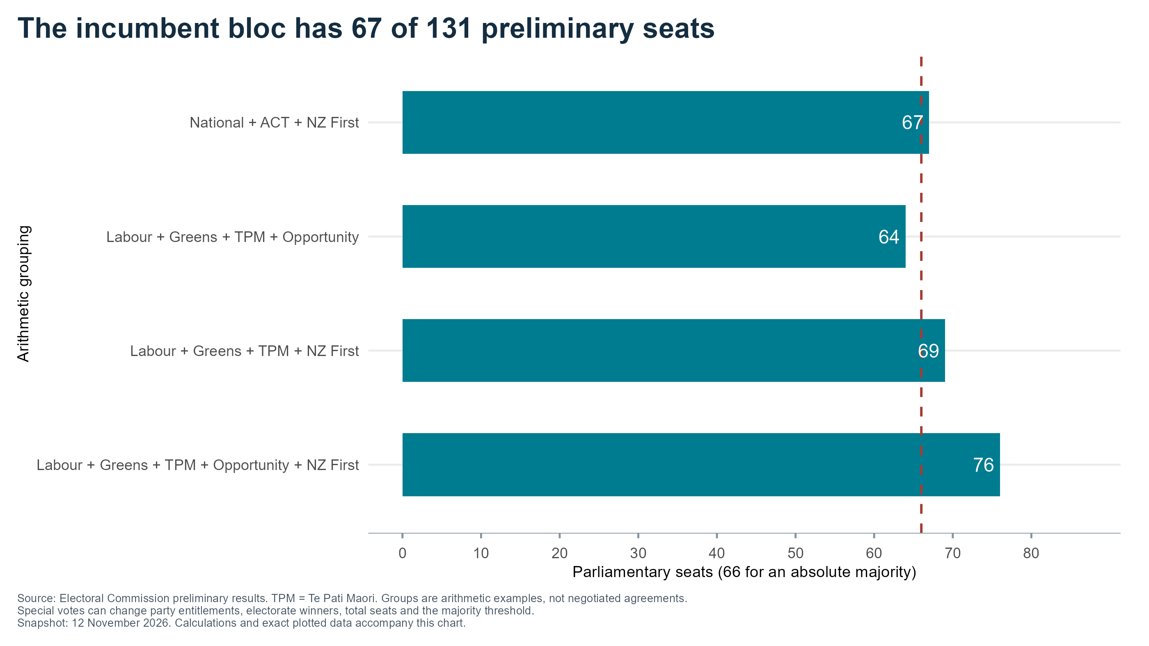
Likely coalition
At face value the current government will return (National-ACT-NZF coalition). However:
Special votes tend to boost left-leaning parties.
Multiple cabinet members lost their seats (including Finance – which is the Treasurer equivalent).
NZF leader went on a podcast saying he wanted to join a coalition with Labour.
Currently, a left coalition would need at least four parties.
Labour, Greens, Te Pāti Māori (left block)
Opportunity (first timers)
New Zealand First (NZF) – if four electorates flip from National to Labour, they would not be needed.

Slide 7
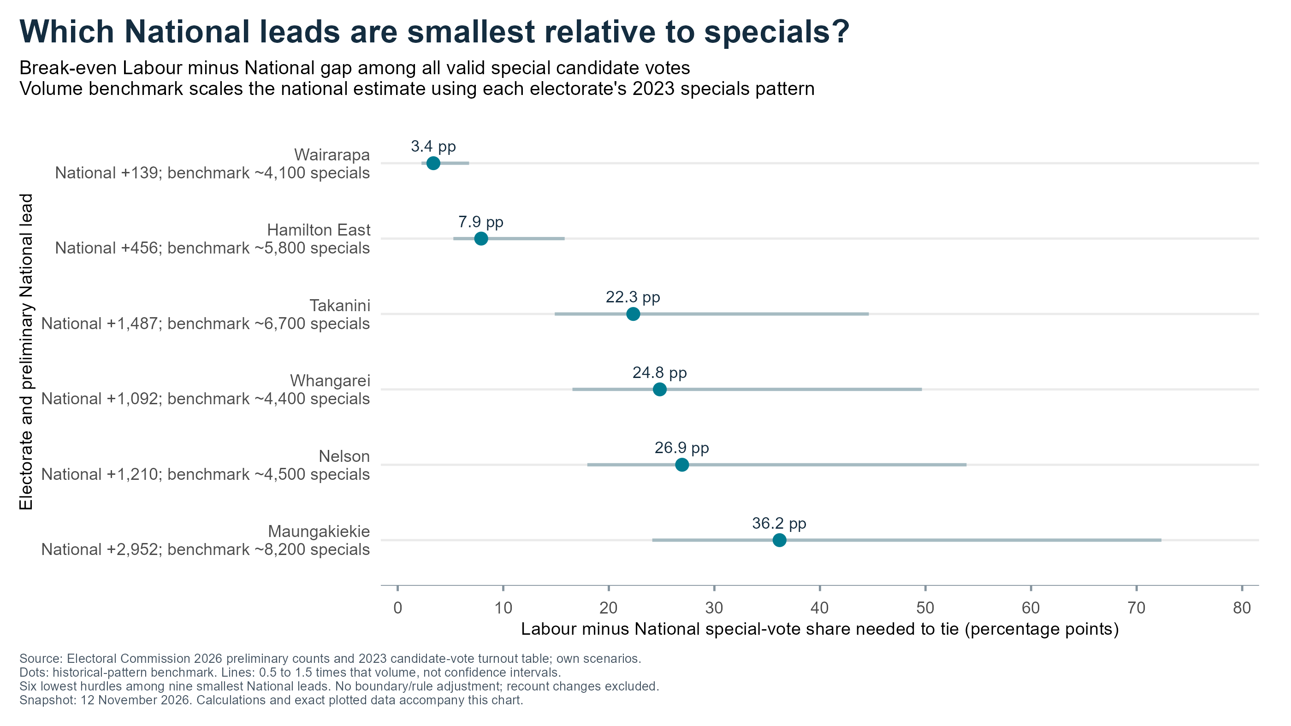
Could electorates change the results?
It is common for a leftward shift in special votes (Greens would gain a seat if their vote share went up around 0.3%). However, distribution of these votes expected to be less skewed this year.
But Left would need party vote change + electoral losses to give three seats for a draw, or four for a left win – and that assumes Opportunity goes left.

Slide 8
What does this mean for policy in the next term
A re-elected centre-right government means:
No capital-gains tax introduced.
Unlikely to replace KiwiSaver with compulsory superannuation (due to coalition partners).
No PBO (due to coalition partners).
Ministry of Regulation will not be shut – other departments likely to be cut further.
Electoral reform more likely to involve cutting electorates (especially Māori), rather than increasing the number of list seats.

